Slide 1
Embedded teams vs. dedicated groups
Jeff Leek
@jtleek
www.jtleek.com

Slide 2
Embedded data scientist
Sits with a diverse team

Slide 3
Product
Marketing
Data team members

Slide 4
Dedicated group data scientist
Sits with a group of data scientists

Slide 5
When do you need data science?

Slide 6
Product
Marketing
Data team members

Slide 7
Keys
Close communication
Support
Empowerment

Slide 8
Communication
Support
Empowerment

Slide 9
Close communication
Know what the problems are
Know the quirks of the data

Slide 10

Drew Conway... advocated that asking good questions is the most critical element in a data science project. And the ability to ask good questions requires domain understanding.
Source: http://bit.ly/1UE35om

Slide 11
Support
Data science is frustrating
Access to knowledge/advice

Slide 12
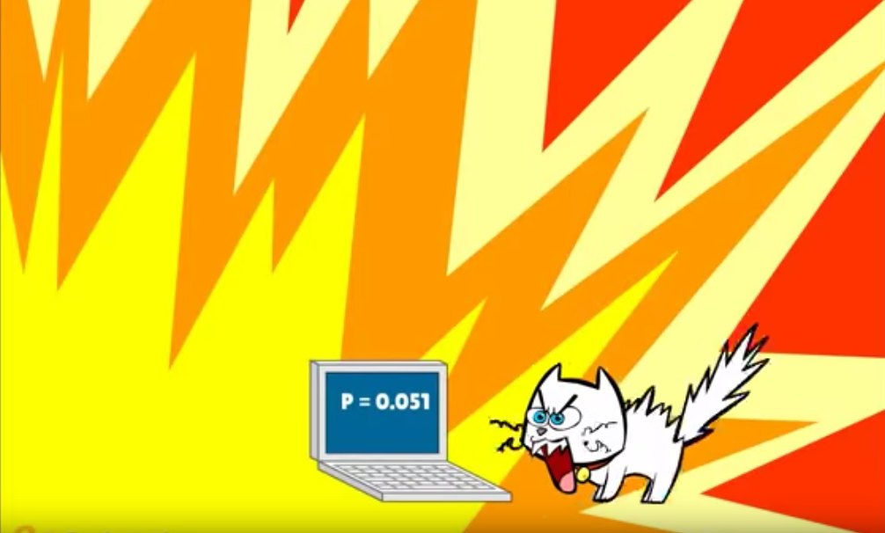
https://www.youtube.com/watch?v=9BIYmw5wnBI

Slide 13
Empowerment
Data is not political
Supported to report accurately

Slide 14
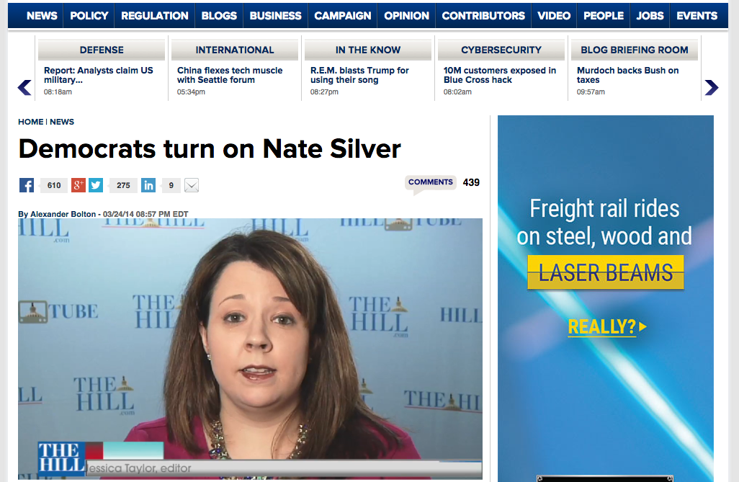
http://thehill.com/homenews/news/201595-democrats-turn-on-nate-silver

Slide 15
Optimal compromise
Sits with manager and team
Regular meetings with “clients”

Slide 16
Product
Marketing
Data team

Slide 17
Product
Marketing
Data team

